Slide 1
Deep Fake
Detection
System

Slide 2
SISTec/BTech/AD/2023/5/MinorProject_I/ 9
ABSTRACT
The proliferation of deep learning technologies has given rise to the alarming emergence of deepfake content, where realistic-looking but fabricated multimedia is created to deceive viewers. This project addresses the pressing need for effective deepfake detection methodologies. Leveraging advanced machine learning algorithms and image processing techniques, our solution aims to discern authentic content from deceptive deepfakes. By analyzing subtle anomalies in facial features, audio patterns, and contextual cues, we strive to enhance the resilience of digital media against malicious manipulation. This research contributes to the ongoing efforts to safeguard the integrity of visual and auditory information in the era of sophisticated synthetic media. This project represents a comprehensive exploration of deep fake detection methodologies, blending traditional forensics with cutting-edge deep learning techniques. It delves into the intricacies of existing deep fake generation methods, discerning key features that distinguish manipulated content from authentic media. The research extends to both image-based and video-based detection strategies, meticulously addressing challenges inherent in each medium. To bolster detection model robustness, the study investigates the fusion of multimodal features, strategically incorporating visual, auditory, and temporal cues. A distinctive contribution lies in the curation of a novel dataset, encompassing a diverse range of deep fake scenarios, facilitating thorough model training and evaluation. Beyond technical considerations, this project critically examines the ethical implications of deep fake technology, emphasizing the need for responsible AI use. Moreover, it explores potential applications of the developed detection methods in various domains such as media forensics, journalism, and online content moderation. The research aims to provide a nuanced understanding of the challenges associated with the manipulation of digital media, offering insights that are invaluable to researchers, practitioners, and policymakers engaged in the responsible deployment of AI in the evolving landscape of multimedia content. Ultimately, this project strives to contribute meaningfully to the ongoing efforts to counter the risks posed by the proliferation of deep fake technology.
i

Slide 3
SISTec/BTech/AD/2023/5/MinorProject_I/ 9
ACKNOWLEDGEMENT
We would like to extend our heartfelt gratitude to various individuals and institutions who have played a significant role in the successful completion of our project, "Design & Development of Deep Fake Detection System."
We are deeply grateful to Sagar Institute of Science & Technology for providing us with the necessary resources, facilities, and a conducive environment for research and learning. This project would not have been possible without the support and opportunities offered by our esteemed institution.
Our heartfelt thanks go to Dr. D.K. Rajoriya, Principal of Sagar Institute of Science & Technology, for granting us the opportunity to undertake this project. We also extend our appreciation to Dr. Swati Saxena, Vice Principal of Sagar Institute of Science & Technology, for their support and encouragement throughout our endeavor.
We acknowledge the invaluable assistance and support provided by Dr. Vasima Khan, Head of the Department of Artificial Intelligence & Data Science, who offered valuable insights and encouragement at various stages of our project.
First and foremost, we wish to express our sincere appreciation to our project guide, Dr. Vasima Khan, for their unwavering support, invaluable guidance, and insightful feedback throughout the course of this project.
Special recognition goes to Prof. Ruchi Jain and Prof. Abhuday Tripathi, Assistant Professors in the Department of Artificial Intelligence & Data Science, for their unwavering support and readiness to address our queries and concerns. Their academic expertise and commitment to our project were truly commendable.
ii

Slide 4
SISTec/BTech/AD/2023/5/MinorProject_I/ 9
LTST OF FTGTTRES
FTG. NO. | TITLE | PAGE NO.
6.1 | System Architecture | 13
6.2 | Data Flow Diagram Level 0 | 14
6.3 | Data Flow Diagram Level 1 | 14
6.4 | Data Flow Diagram Level 2 | 15
6.5 | System Sequence | 16
6.6 | Use Case Diagram | 16
7.1 | Home Page | 18
7.2 | Input Interface | 18
7.3 | Face Detection | 19
iii

Slide 5
SISTec/BTech/AD/2023/5/MinorProject_I/ 9
LTST OF ABBREVIATIONS
ACRONYM | FULL FORM
HTML | Hyper Text Markup Language
CSS | Cascading Style Sheets
RNN | Recurrent Neural Network
DFD | Deep Fake Detection
LRCN | Long-term Recurrent Convolution Network
CNN | Convolutional Neural Networks
LSTM | Long Short-Term Memory
GAN | Generative Adversarial Network
SVM | Support Vector Machine
iv

Slide 6
SISTec/BTech/AD/2023/5/MinorProject_I/ 9
TABLE OF CONTENTS
TITLE |  |  | PAGE NO.
Abstract |  |  | i
Acknowledgement |  |  | ii
List of figures |  |  | iii
List of abbreviations |  |  | iv
Chapter 1 | Introduction |  | 1
 | 1.1 | About Project | 2
 | 1.2 | Significance of Deep Fake Detection | 3
Chapter 2 | Software & Hardware Requirements |  | 4
Chapter 3 | Problem Description |  | 6
Chapter 4 | Literature Survey |  | 8
Chapter 5 | Software Requirements Specification |  | 10
 | 5.1 | Functional Requirements | 11
 | 5.2 | Non-Functional Requirements | 11
Chapter 6 | Software Design |  | 12
 | 6.1 | Overview | 13
 | 6.2 | System Architecture | 13
 | 6.2 | Data Flow Diagrams | 14-15
 | 6.4 | Sequence Diagram | 16
 | 6.5 | Use Case Diagram | 16
Chapter 7 | Output Screens |  | 17-19
Chapter 8 | Deployment |  | 20
Appendix-1: Glossary of Terms |  |  | 22-23
Appendix-2: References |  |  | 24
Appendix-3: Project Summary |  |  | 25-28
v

Slide 7


Slide 8
SISTec/BTech/AD/2023/5/MinorProject_I/ 9
CHAPTER-1
INTRODUCTION
1.1 ABOUT THE PROJECT
In response to the rapid evolution of technology, the "Advancements in Deep Fake Detection" project tackles the challenge of identifying manipulated content using state-of-the-art Machine learning techniques. By meticulously analyzing diverse datasets of manipulated videos and images, the project aims to unveil subtle patterns that reveal the authenticity of digital media. Employing innovative approaches in machine learning and digital forensics, the project endeavors to create a reliable tool empowering individuals and organizations to effectively identify and counter deep fake threats online.
This project holds immense significance in the digital landscape, where the authenticity of multimedia content is paramount. By harnessing data-driven methodologies and predictive analytics, the deep fake detection model aims to bolster the defenses against deceptive media, ensuring a safer and more trustworthy online environment. Its outcomes have far-reaching implications for cybersecurity, journalism, and digital communication, enabling society to navigate the digital realm with increased awareness and resilience against the ever-evolving challenges posed by deep fake technology
Deepfake creation tools leave distinctive artefacts in the resulting Deep Fake videos, and we show that they can be effectively captured by Res-Next Convolution Neural Networks. Our system uses a Res-Next Convolution Neural Networks to extract frame-level features. These features are then used to train a Long Short Term Memory (LSTM) based Recurrent Neural Network (RNN) to classify whether the video is subject to any kind of manipulation or not, i.e whether the video is deep fake or real video. We proposed to evaluate our method against a large set of deep fake videos collected from multiple video websites. We are tried to make the deep fake detection model perform better on real time data. To achieve this we trained our model on combination of available data-sets .So that our model can learn the features from different kind of images. We extracted a adequate amount of videos from Face-Forensic++ [7], Deepfake detection challenge [8], and Celeb-DF [9] data-sets. We also evaluated our model against the large amount of real time data like YouTube data-set to achieve competitive results in the real time scenario’s.
2

Slide 9
SISTec/BTech/AD/2023/5/MinorProject_I/ 9
• PROJECT OBJECTIVES
The primary objectives of this project are as follows:
♦ Developing an Advanced Detection Model: Develop a precise deep fake detection system using cutting-edge machine learning techniques for accurate identification of manipulated content.
♦ Data Compilation and Refinement: Curate a diverse dataset of manipulated multimedia and refine it to extract crucial features, forming a strong foundation for training the detection model.
♦ Model Assessment and Verification: Assess the detection model rigorously using various algorithms and metrics to ensure its effectiveness in recognizing complex patterns in deep fake media.
♦ User-Friendly Interface Development: Create an intuitive interface enabling users to input media for seamless detection.
♦ Empowering Users and Industry Professionals: Offer a valuable tool to individuals and industry professionals.
♦ Enhance Skills: Provide practical experience in data processing, feature extraction , machine learning, fostering expertise in countering digital manipulation effectively
1.2 SIGNIFICANCE OF DEEP FAKE DETECTION
The importance of a robust deep fake detection system in today's digital landscape cannot be emphasized enough. For the general public, having access to accurate tools for identifying manipulated content is crucial. It empowers individuals to navigate online platforms with confidence, ensuring that the information they encounter is trustworthy and authentic. This capability not only safeguards users from falling victim to misinformation but also fosters a safer digital environment, promoting responsible online behavior.
In addition to individual users, social media platforms, news organizations, and government agencies greatly benefit from effective deep fake detection technology. By implementing reliable detection systems, these entities can curb the spread of deceptive content, maintain the integrity of their platforms, and uphold public trust. Furthermore, researchers and cybersecurity experts working in the digital domain rely on accurate deep fake detection methods to study evolving threats and develop strategies to counter digital manipulation effectively.
The project's objective to develop a precise deep fake detection model aligns with these pressing needs, offering a practical solution that strengthens digital security, preserves authenticity, and fortifies society against the harmful impact of manipulated media.
3

Slide 10
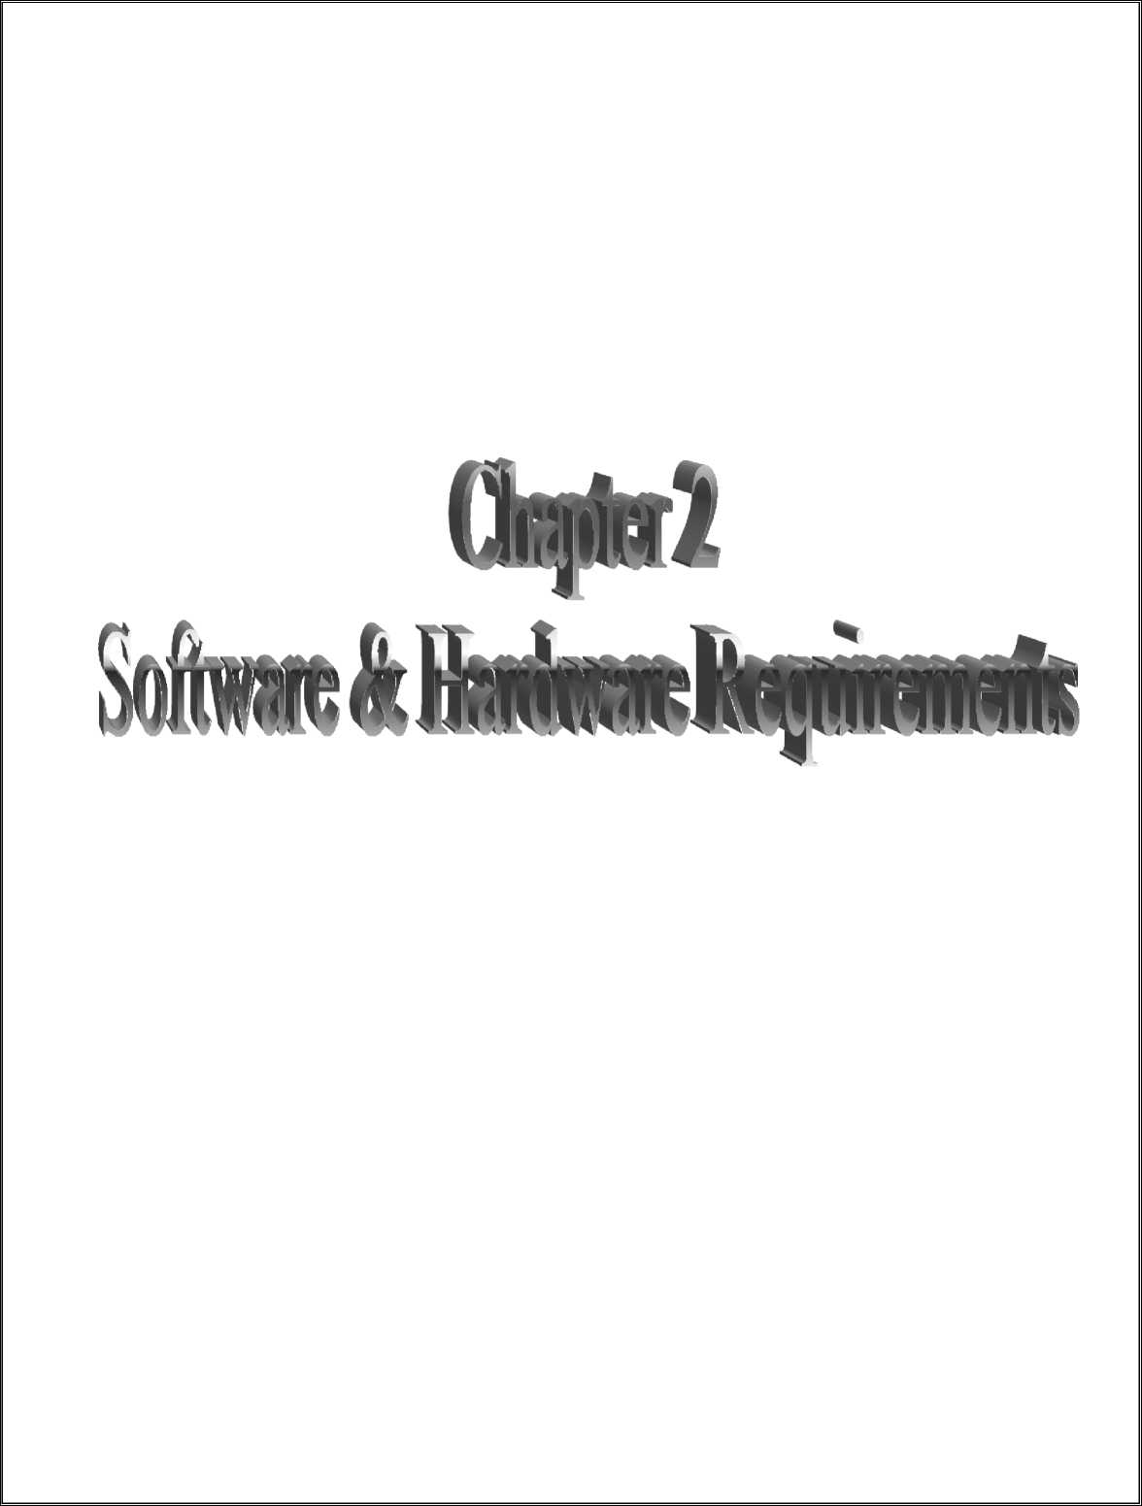

Slide 11
SISTec/BTech/AD/2023/5/MinorProject I/9
CHAPTER-2
SOFTWARE & HARDWARE REQUIREMENTS
2.1 SOFTWARE REQUIREMENTS
The successful development and deployment of the "Design and Development of Deep Fake Detection System" project necessitate the utilization of specific software tools and technologies. This section outlines the software requirements vital to the project's execution.
• Operating System: Windows 10 or higher
• Programming Language: Python (3.0) or higher
• Framework: Django (3.0) or higher
• Libraries: cv2, face_recognition, scikit-learn, torch, torchvision, pandas, numpy, random.
2.2 HARDWARE REQUIREMENTS
The "Design and Development of DFD " project demands specific hardware resources to ensure its smooth operation. The minimum hardware requirements include:
CPU | : 3.5 GHz
RAM | : 16 GB
Hard Disk | : 100 GB
GPU | : NVIDIA high-end GPU with at least 6 GB VRAM
• Client-Side Requirements: Browser (Any Compatible browser device)
5

Slide 12


Slide 13
SISTec/BTech/AD/2023/5/MinorProject_I/9
CHAPTER-3 PROBLEM DESCRIPTION
In recent years, the rapid advancement of artificial intelligence and deep learning techniques has given rise to a pervasive issue: the proliferation of deep fake content. Deep fakes are convincingly manipulated videos, images, or audio recordings created using sophisticated algorithms, making it challenging to distinguish them from authentic media. This digital manipulation poses severe threats to various sectors, including politics, journalism, and online trust, as malicious actors exploit deep fakes to spread misinformation, deceive the public, and compromise the integrity of information sources.
The problem at hand revolves around the urgent need to develop robust and accurate deep fake detection methods. Existing detection techniques often struggle to keep pace with the evolving sophistication of deep fakes, leading to a growing gap between the creation of deceptive media and the ability to identify it. Addressing this challenge requires innovative solutions that can discern subtle discrepancies between genuine and manipulated content across various multimedia formats. Furthermore, these solutions must be efficient, scalable, and adaptable to different contexts, enabling timely detection and mitigation of the harmful effects of deep fake technology. Developing effective methods for deep fake detection is critical for preserving the authenticity of digital media, rebuilding trust in online content, and safeguarding the integrity of information sources in the digital age.
Detecting deep fakes is crucial to combat misinformation, protect privacy, and uphold legal integrity. As these manipulations become more advanced, continuous innovation in technologies like machine learning and computer vision is essential. Safeguarding reliable information and ensuring digital security necessitate ongoing collaboration and vigilance across disciplines, promoting a safer online environment globally.
7

Slide 14

os. 9

Slide 15
SISTec/BTech/AD/2023/5/MinorProject I/9
CHAPTER-4 LITERATURE SURVEY
Face Warping Artifacts [1] used the approach to detect artifacts by comparing the generated face areas and their surrounding regions with a dedicated Convolutional Neural Network model. In this work there were two-fold of Face Artifacts. Their method is based on the observations that current deepfake algorithm can only generate images of limited resolutions, which are then needed to be further transformed to match the faces to be replaced in the source video. Their method has not considered the temporal analysis of the frames. Detection by Eye Blinking [2] describes a new method for detecting the deepfakes by the eye blinking as a crucial parameter leading to classification of the videos as deepfake or pristine. The Long-term Recurrent Convolution Network (LRCN) was used for temporal analysis of the cropped frames of eye blinking. As today the deepfake generation algorithms have become so powerful that lack of eye blinking can not be the only clue for detection of the deepfakes. There must be certain other parameters must be considered for the detection of deepfakes like teeth enchantment, wrinkles on faces, wrong placement of eyebrows etc. Capsule networks to detect forged images and videos [3] uses a method that uses a capsule network to detect forged, manipulated images and videos in different scenarios, like replay attack detection and computer-generated video detection. In their method, they have used random noise in the training phase which is not a good option. Still the model performed beneficial in their dataset but may fail on real time data due to noise in training. Our method is proposed to be trained on noiseless and real time datasets. Recurrent Neural Network [4] (RNN) for deepfake detection used the approach of using RNN for sequential processing of the frames along with ImageNet pre-trained model. Their process used the HOHO [5] dataset consisting of just 600 videos. Their dataset consists small number of videos and same type of videos, which may not perform very well on the real time data. We will be training out model on large number of Realtime data.
Synthetic Portrait Videos using Biological Signals [6] approach extract biological signals from facial regions on pristine and deepfake portrait video pairs. Applied transformations to compute the spatial coherence and temporal consistency, capture the signal characteristics in feature vector and photoplethysmography (PPG) maps, and further train a probabilistic Support Vector Machine (SVM) and a Convolutional Neural Network (CNN).
Then, the average of authenticity probabilities is used to classify whether the video is a deepfake or a pristine. Deep Fake Detection System detects fake content with high accuracy, independent of the generator, content, resolution, and quality of the video. Due to lack of discriminator leading to the loss in their findings to preserve biological signals, formulating a differentiable loss function that follows the proposed signal processing steps is not straight forward process.
9

Slide 16


Slide 17
SISTec/BTech/AD/2023/5/MinorProject_I/9
CHAPTER-5
SOFTWARE REQUIREMENTS SPECIFICATION
This chapter outlines the functional and non-functional requirements of the "Design and Development of Deep Fake Detection System." Subsequent chapters will delve into the software design and development, providing a detailed understanding of how these requirements will be realized.
5.1 FUNCTIONAL REQUIREMENTS
The "Design and Development of Deep Fake Detection System" project encompasses a range of functional and non-functional requirements crucial for the project's success.
• Multimedia Analysis: The system must analyze images, videos file to detect potential manipulations and anomalies.
• Real-time Detection: The system should offer real-time deep fake detection capabilities to identify manipulated content promptly, the system should quickly spot fake videos as they appear
• User Interface: The user interface should provide an intuitive and user-friendly experience, enabling effortless uploading and analysis of multimedia content. Visualization tools, such as heatmaps and side-by-side comparisons, should enhance user understanding of the detection results.
• Data Preprocessing: Gather a diverse dataset containing authentic videos and deep fake videos, extract frames from each video to create a collection of individual images.
5.2 NON- FUNCTIONAL REQUIREMENTS
In addition to functional requirements, the project has non-functional requirements that focus on the system's quality, performance, and usability.
• Usability: The user interface should be intuitive and user-friendly, catering to users with varying levels of technical expertise.
• Efficiency: The detection algorithms must provide accurate and reliable results, minimizing the chance of failure.
11

Slide 18

SISTec/BTech/AD/2023/5/MinorProject_I/9

Slide 19

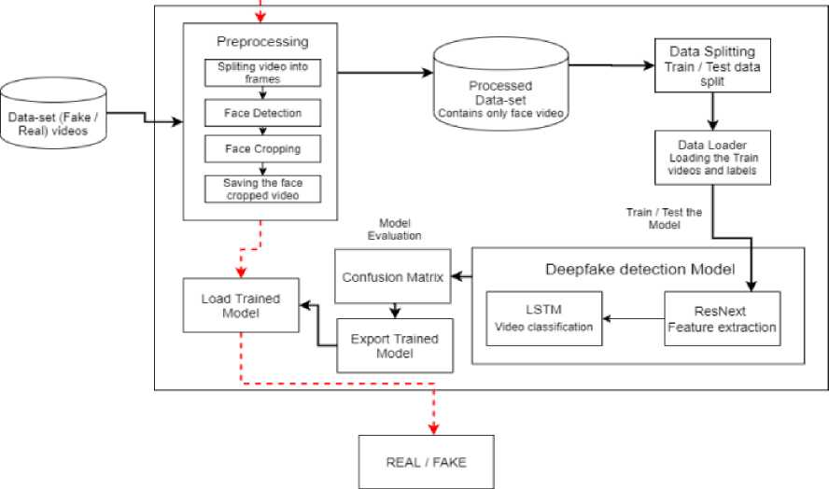
SISTec/BTech/AD/2023/5/MinorProject_I/9
CHAPTER-6 SOFTWARE DESIGN
6.1 OVERVIEW
This chapter outlines the software design for the "Design and Development of Deep Fake Detection System" project.
6.2 SYSTEM ARCHITECTURE
The software architecture consists of data collection and preprocessing, a machine learning model, a user interface, and model evaluation.
■> Trainir>g Flow > Prediction Flow
Fig (6.1): System Architecture
13

Slide 20
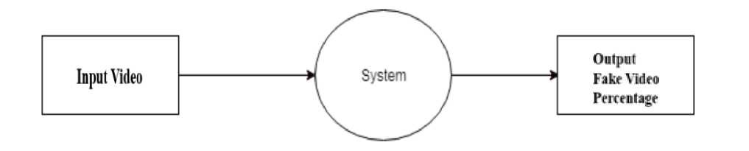
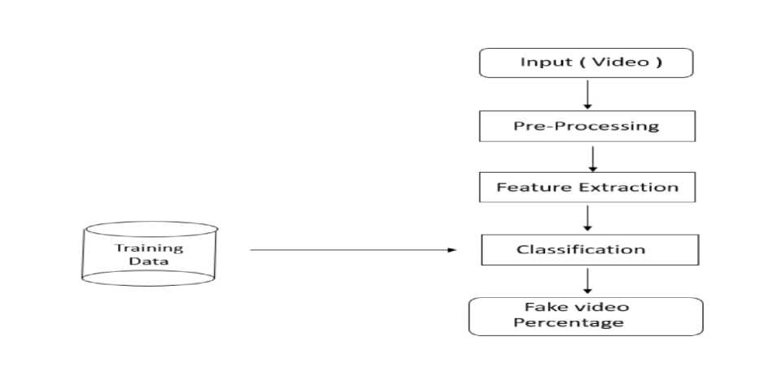
SISTec/BTech/AD/2023/5/MinorProject_I/9
6.3 DATA FLOW
The data flow begins with data collection and preprocessing, followed by model training, user input handling, and model evaluation. This structure ensures accurate deep fake detection.
Fig (6.2): Data Flow Diagram Level 0
DFD level - 0 indicates the basic flow of data in the system. In this System Input is given equal importance as that for Output.
• Input: Here input to the system is uploading video.
• System: In system it shows all the details of the Video.
• Output: Output of this system is it shows the fake video or not.
Hence, the data flow diagram indicates the visualization of system with its Input and output flow.
Fig (6.3): Data Flow Diagram Level 1
14

Slide 21
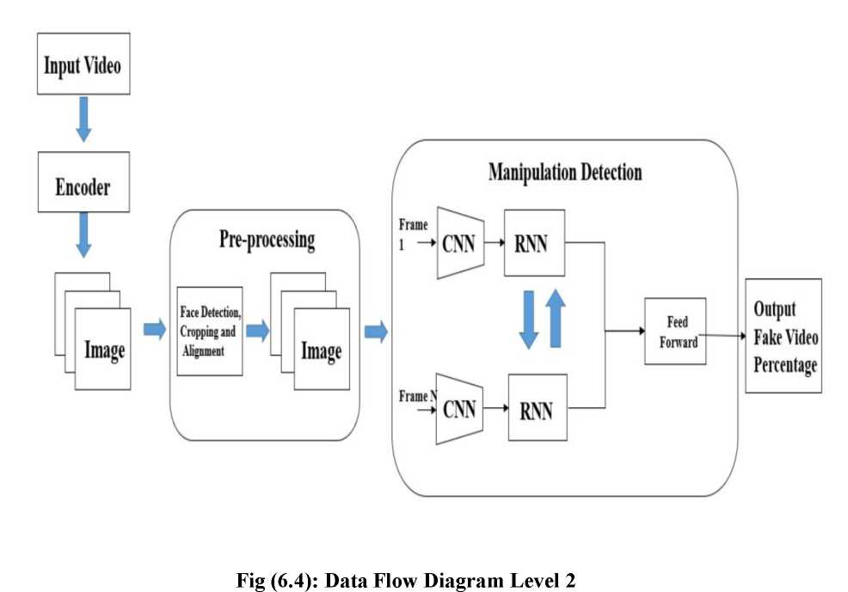
SISTec/BTech/AD/2023/5/MinorProject_I/9
[1] DFD Level - 1 gives more in and out information of the system.
[2] Where system gives detailed information of the procedure taking place.
[1] DFD level-2 enhances the functionality used by user etc.
15

Slide 22
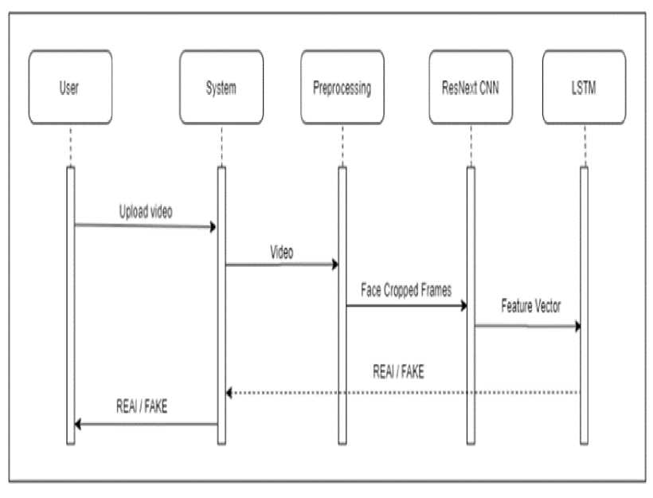
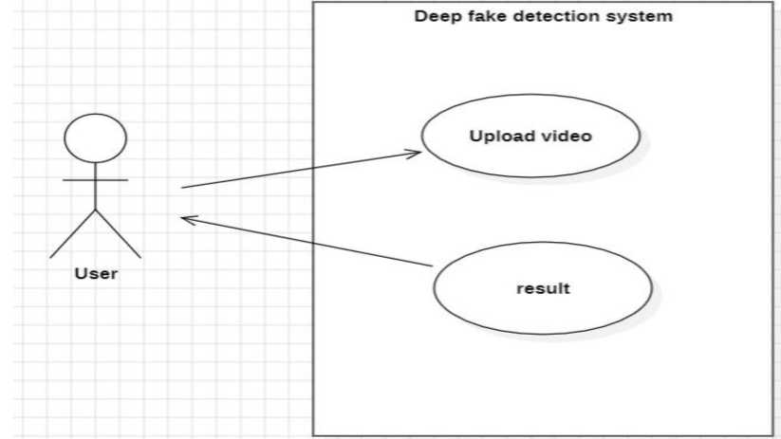
6.4 SYSTEM SEQUENCE DIAGRAM
Fig (6.5): System Sequence
6.5 USE CASE DIAGRAM
Fig (6.6): Use Case Diagram

Slide 23


Slide 24

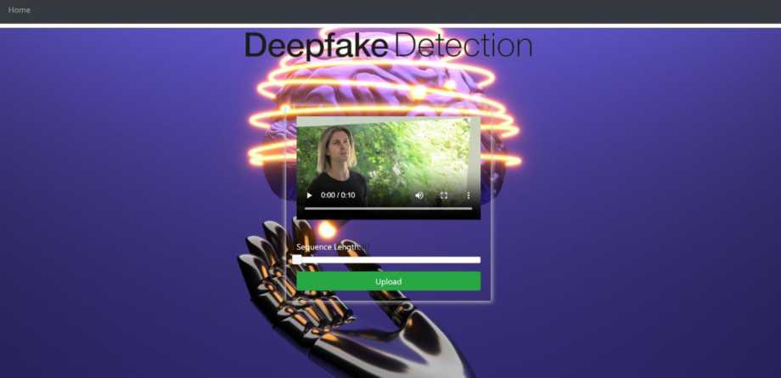
SISTec/BTech/AD/2023/5/MinorProject I/9
CHAPTER-7 OUTPUT SCREENS
This chapter presents visual representations of the user interface for the "Deep Fake Detection System”.
Home Page: The entry point for users, offering navigation options.
Fig (7.1): Home Page Input Interface: Allows users to input
Fig (7.2): Input Interface
18

Slide 25
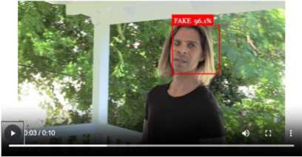

SISTec/BTech/AD/2023/5/MinorProject I/9
Face Detection: Displays accurate Face Detection after user upload video or image files.
Home
Deepfake Detection
Play to see Result
Result: FAKE
Fig (7.3): Face Detection
19

Slide 26


Slide 27
SISTec/BTech/AD/2023/5/MinorProject_I/9
CHAPTER-8
DEPLOYMENT
In this chapter, we outline our deployment plans for the "Design and Development of Deep Fake Detection System". The model is currently in development, and while it has not been deployed yet, we provide an overview of our deployment strategy.
8.1 Hosting Environment
We are in the process of selecting an appropriate hosting environment based on factors such as scalability, performance, and security.
8.2 Model Deployment Strategy
Once the model is ready, we will serialize it into a deployable format, integrate it into a web application, and enable deep fake detection.
8.3 User Accessibility
We plan to make the web-based interface accessible to users through a user-friendly URL.
8.4 Scalability
Our deployment strategy will consider scalability to accommodate an increasing number of users and larger datasets.
8.5 Monitoring and Maintenance
A monitoring and maintenance plan will be established to ensure the model's continued performance.
The deployment of the deep fake detection model is currently in the planning stage, and the steps and considerations mentioned in this chapter will be implemented when the model is ready for deployment.
21

Slide 28
SISTec/BTech/AD/2023/5/MinorProject_I/9
APPENDIX-1 | GLOSSARY OF TERMS
(In alphabetical order)
B
Bias in Data | Unintended patterns in the data that can affect the model's predictions, often requiring mitigation during preprocessing.
D
Data Collection | The process of gathering relevant data from various sources to be used for model training.
Data Preprocessing | Cleaning and preparing data to ensure its quality and suitability for model training.
Deployment | The process of making the model accessible to users for real-time predictions.
F
Feature Engineering | The process of selecting and creating relevant features from the dataset to improve the model's predictive accuracy.
Feature Extraction | The process of selecting and creating relevant features from the dataset to improve the model's predictive accuracy.
G
Geographical Variations | Differences in car prices due to location or region, which need to be considered in the model.
H
Hosting Environment | The infrastructure or platform where the application and model will be hosted and made accessible to users.
M
Machine Learning Model | A mathematical model that uses algorithms to predict or classify data based on input features. In this project, it predicts car prices based on car attributes.
Model Evaluation | The process of assessing the performance and accuracy of the machine learning model using various metrics.
22

Slide 29
Monitoring and Maintenance | A plan for continuous monitoring and upkeep of the model and application to ensure optimal performance.
S
Scalability | The system's ability to handle an increasing number of users and larger datasets without a significant decrease in performance.
Serializing | Converting the machine learning model into a deployable format, often used for saving and loading models.
U
User Interface | The graphical or web-based interface through which users can interact with the car price prediction model.
V
Version Control | The practice of tracking changes made to code and other project files, often managed using tools like Git.
23

Slide 30
SISTec/BTech/AD/2023/5/MinorProiect I/9
REFERENCES
[1] Yuezun Li, Siwei Lyu, “ExposingDF Videos By Detecting Face Warping Artifacts,” in arXiv: 1811.00656v3.
[2] Yuezun Li, Ming-Ching Chang and Siwei Lyu “Exposing AI Created Fake Videos by Detecting Eye Blinking” in arXiv:1806.02877v2.
[3] Huy H. Nguyen , Junichi Yamagishi, and Isao Echizen “ Using capsule networks to detect forged images and videos ” in arXiv:1810.11215.
[4] D. Guera and E. J. Delp, "Deepfake Video Detection Using Recurrent Neural Networks," 2018 15th IEEE International Conference on Advanced Video and Signal Based Surveillance (AVSS), Auckland, New Zealand, 2018, pp. 1-6.
[5] I. Laptev, M. Marszalek, C. Schmid, and B. Rozenfeld. Learning realistic human actions from movies. Proceedings of the IEEE Conference on Computer Vision and Pattern Recognition, pages 1-8, June 2008. Anchorage, AK
[6] Umur Aybars Ciftci, Ilke Demir, Lijun Yin “Detection of Synthetic Portrait Videos using Biological Signals” in arXiv:1901.02212v2
[7] Andreas Rossler, Davide Cozzolino, Luisa Verdoliva, Christian Riess, Justus Thies, Matthias Niebner, “Face Forensics++: Learning to Detect Manipulated Facial Images” in arXiv:1901.08971.
[8] Deepfake detection challenge dataset: https://www.kaggle.com/c/deepfake-detectionchallenge/
[9] Yuezun Li , Xin Yang , Pu Sun , Honggang Qi and Siwei Lyu “Celeb-DF: A Large-scale Challenging Dataset for DeepFake Forensics” in arXiv:1909.12962
24

